Slide 2
2022 marks our 150th year of service in this community…

Slide 3
C
O
U
Leading up
to that event,
we want to
challenge the
congregation…
F
S
…to focus on
its discipleship
with 20 goals
in 20 months

Slide 4
Faithful Worship Open-Hearted Generosity Courageous Mission & Service Unconditional Hospitality Strategic Faith Development

Slide 5
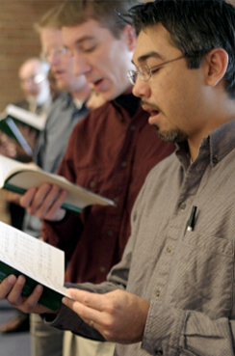
Faithful Worship
20 new worship opportunities
20% increase in worship attendance
20% increase in praise band members

Slide 6
Open-Hearted Generosity
20 new pledges
each year
20 increased pledges each year

Slide 7
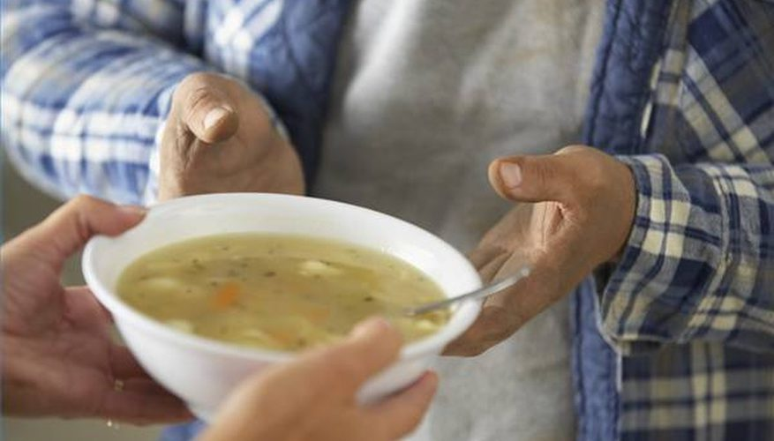
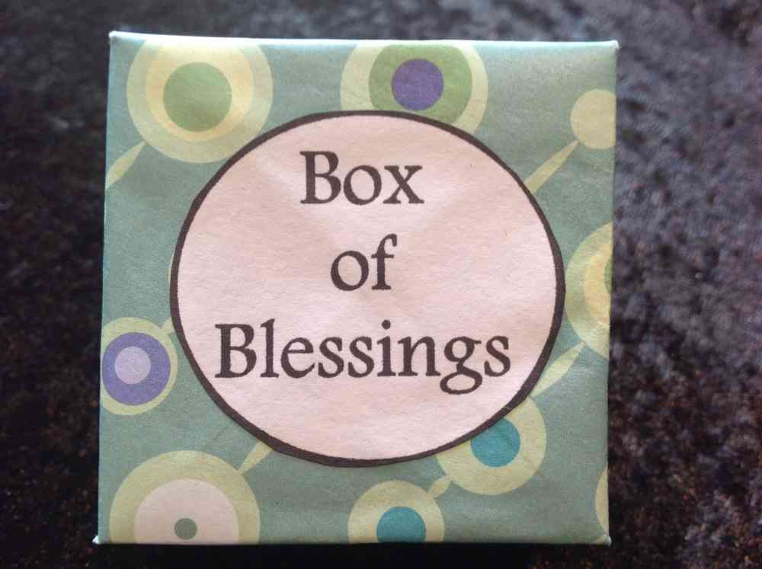
Courageous Mission & Service
“200 Club” for 200 hours of service
20 new mission participants
20 youth involved in mission projects
20 Boxes of Blessings each quarter
20 mission trip participants to House of Hope

Slide 8
Unconditional Hospitality
20 intentional invites to Federated
20 new members
20 inactive members re-engaging
20 members at church work days
20 people attending fellowship events

Slide 9
Strategic Faith Development
20 new kids in Sunday School
20 new kids in Kids’ Club
20 new kids in VBS
20 Jr/Sr highs in weekly youth group
20 members in Doug’s “Breathing with God” seminar

Slide 10
As each has received a gift,
use it to serve one another,
as good stewards
of God’s varied grace.
1 Peter 4:10

